Slide 1
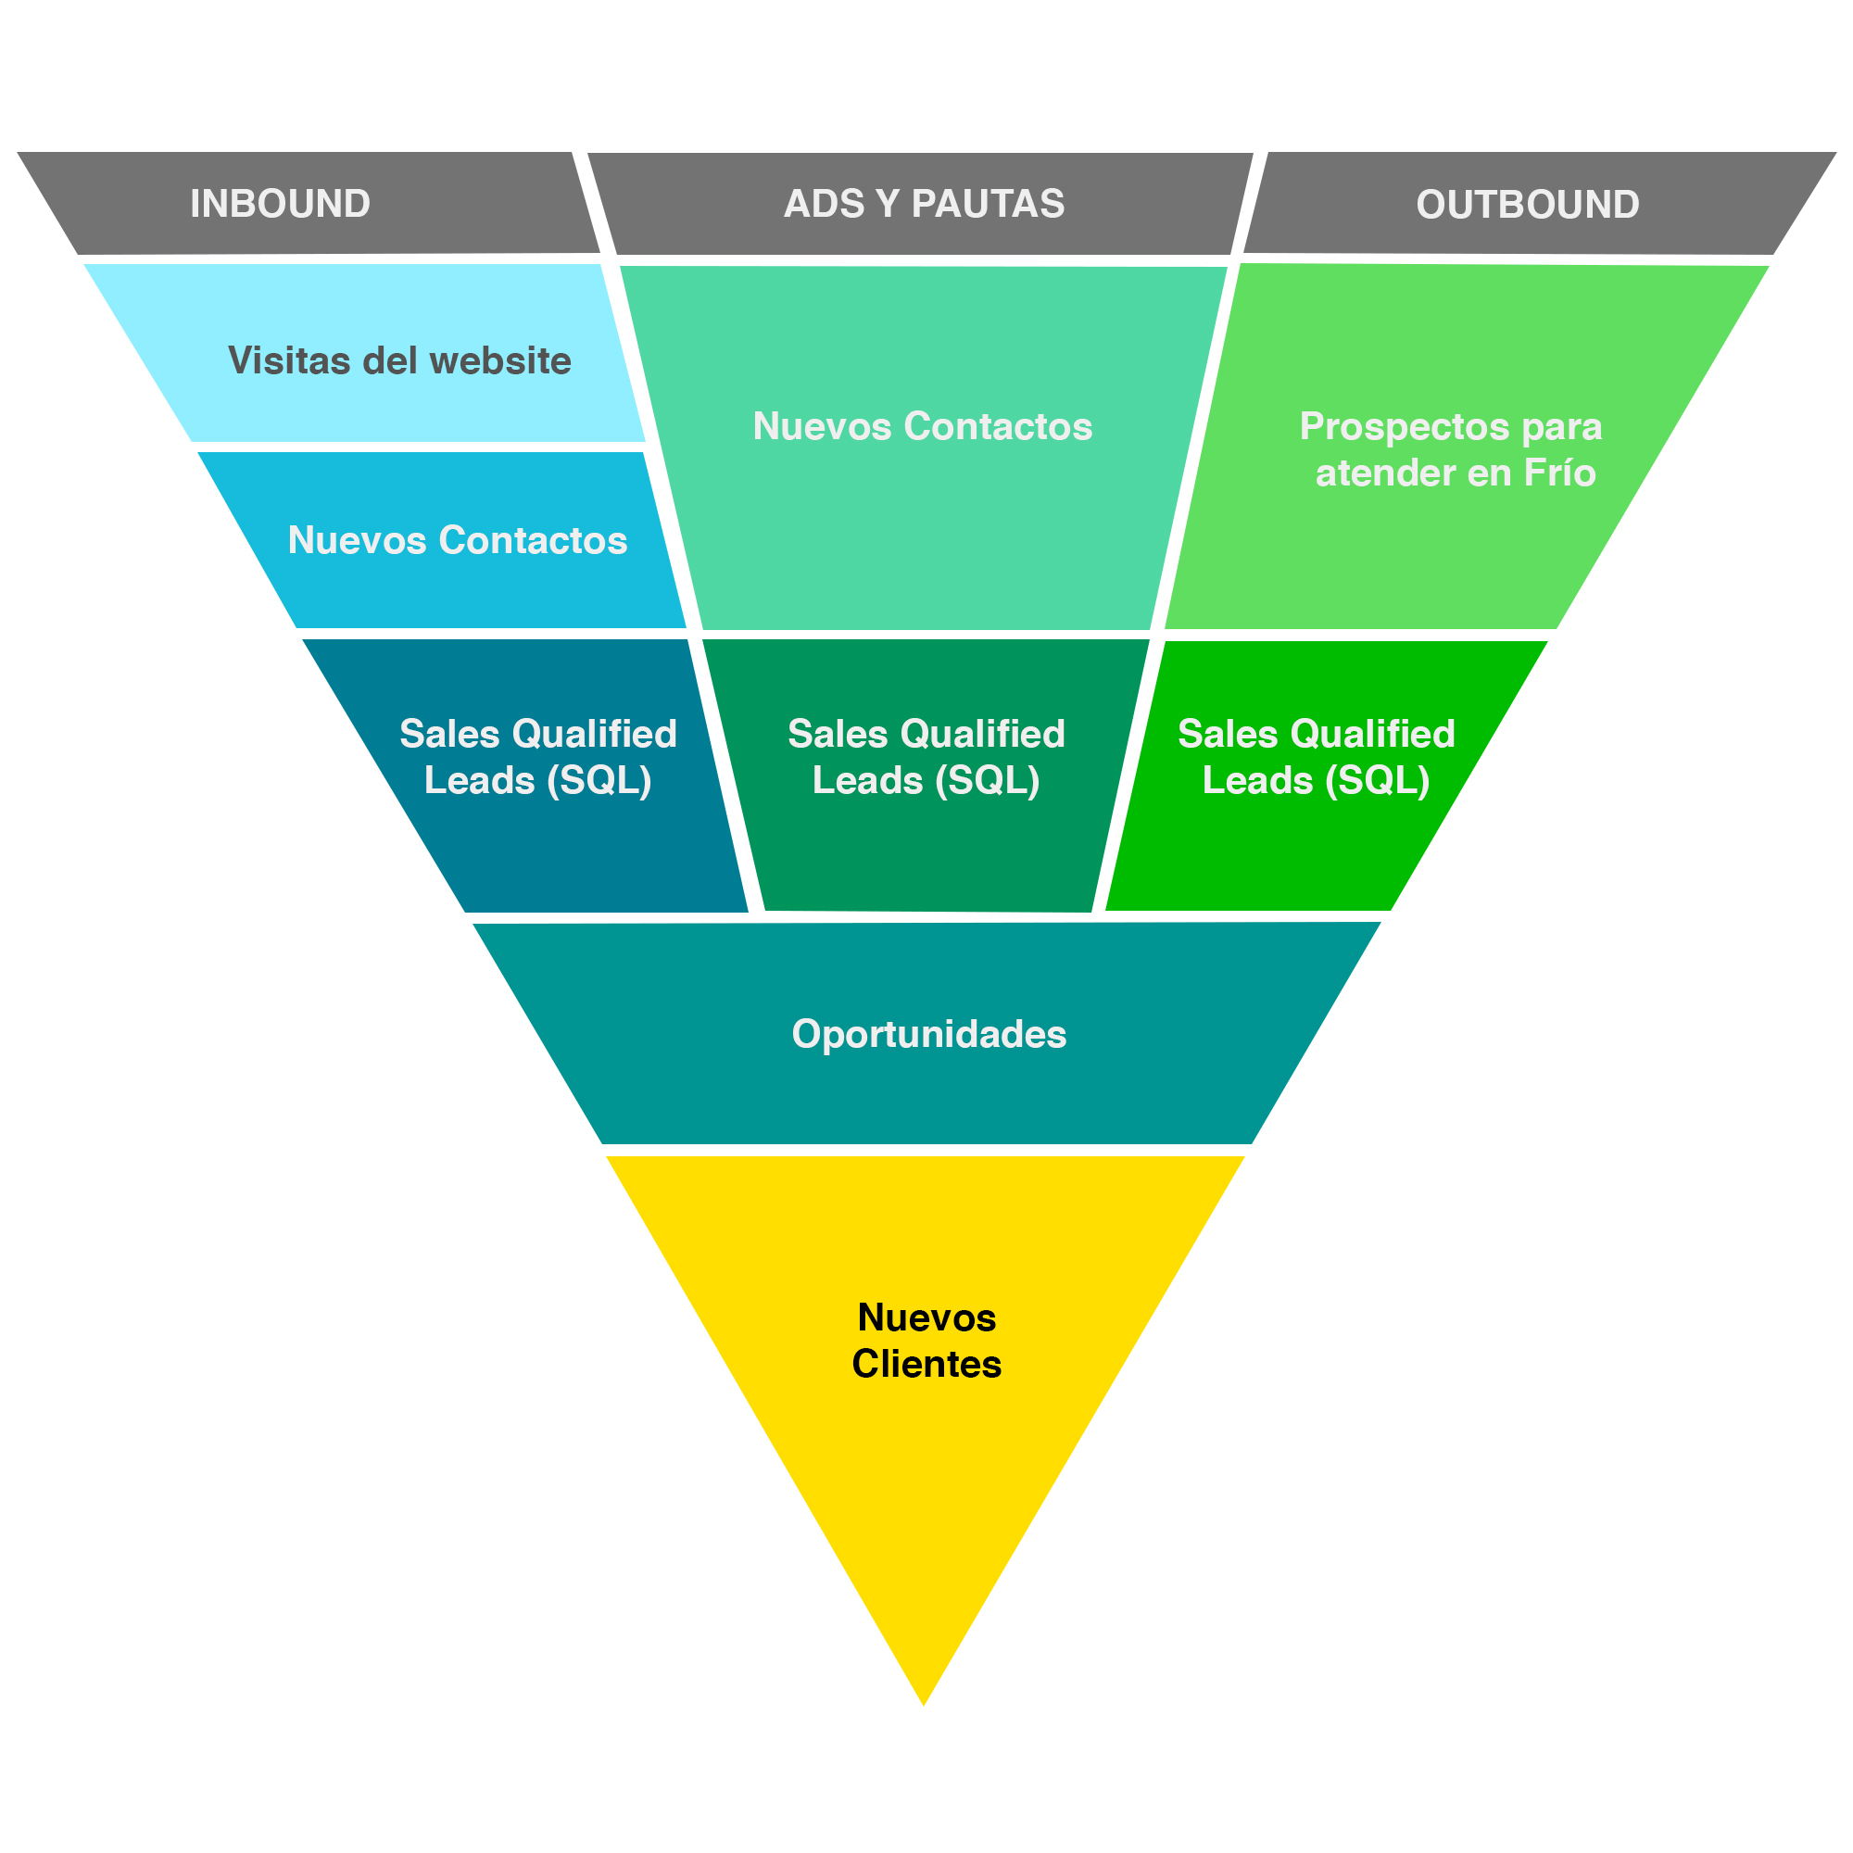
0
0
0
0
0
0
0
0
0
www.brauermkt.com
Brauer Industrial Marketing

